Slide 1


Hello!
PROJECT SEMESTER 1

Slide 2

Team Presentation
Le Thi Thanh Hien

Slide 3
BUILDING CLEAN AGRICULTURAL PRODUCTS BUSINESS WEBSITE
3

Slide 4
1.
Introduce
Let’s start with the first set of slides
4

Slide 5


Reasons for choosing the topic

Slide 6
The goal of the topic

Slide 7

Helping customers to choose and shop anytime, anywhere.
Help the store manage the purchase and sale more effectively.

Slide 8
2. OVERVIEW OF THE SITE FOR SALE CLEAN AGRICULTURE PRODUCTS ONLY
8

Slide 9
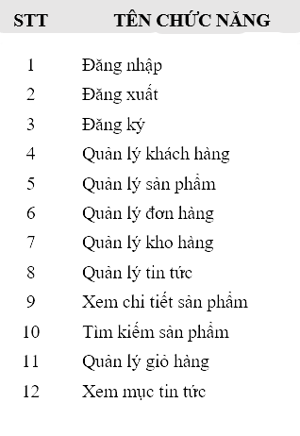
System functions:
User groups
Administrator: This user group has the highest authority on the system.
Customers: Includes potential and customers .

Slide 10
3. SYSTEM ANALYSIS AND DESIGN
10

Slide 11
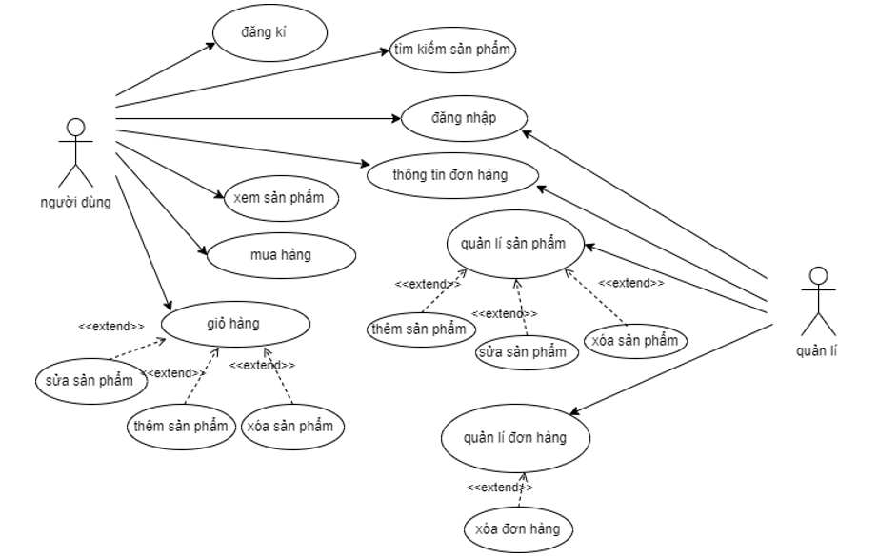
Use case diagram:

Slide 12
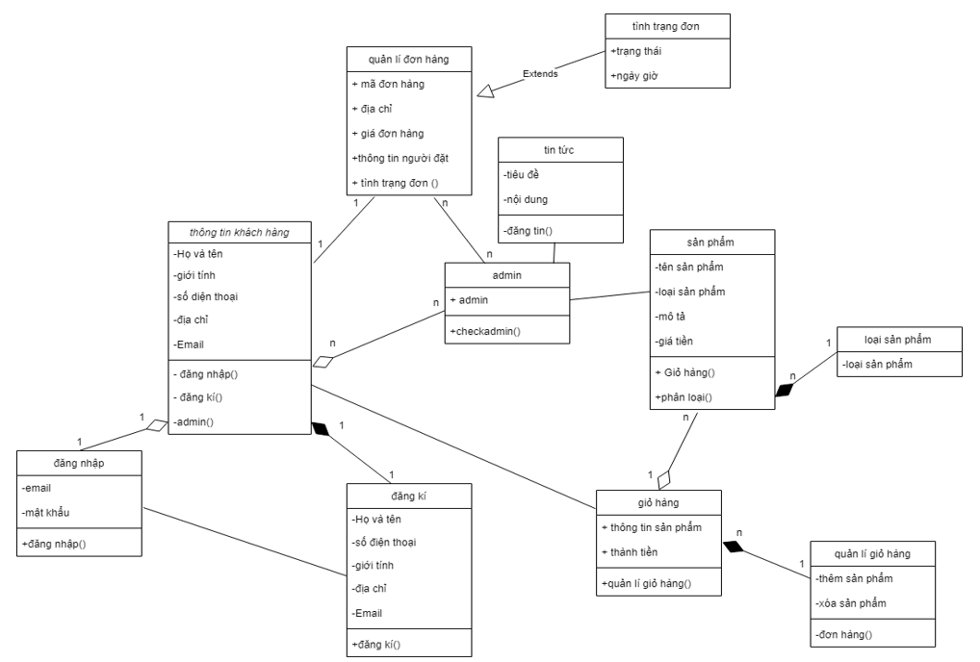
Class diagram:

Slide 13
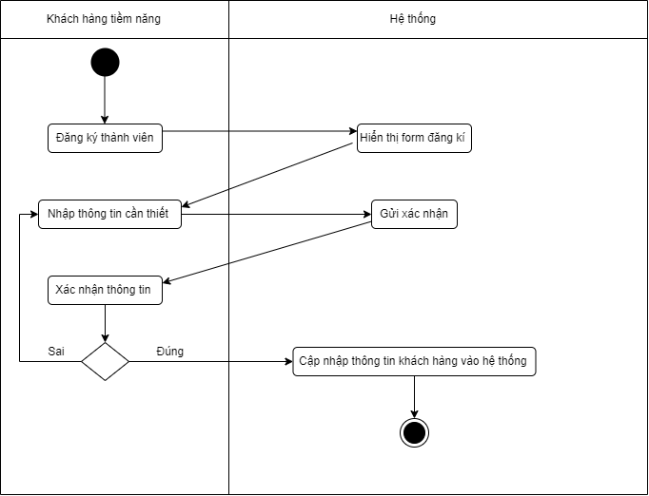
Activity diagram
Registration activity diagram

Slide 14
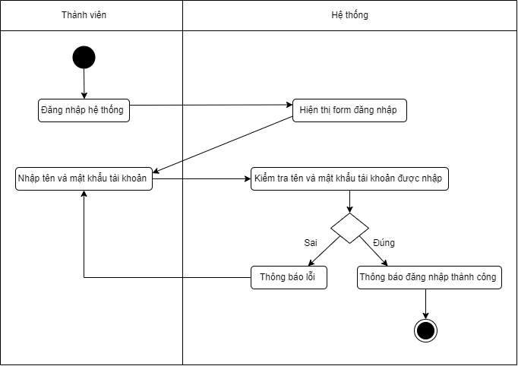
Activity diagram
Login activity diagram

Slide 15
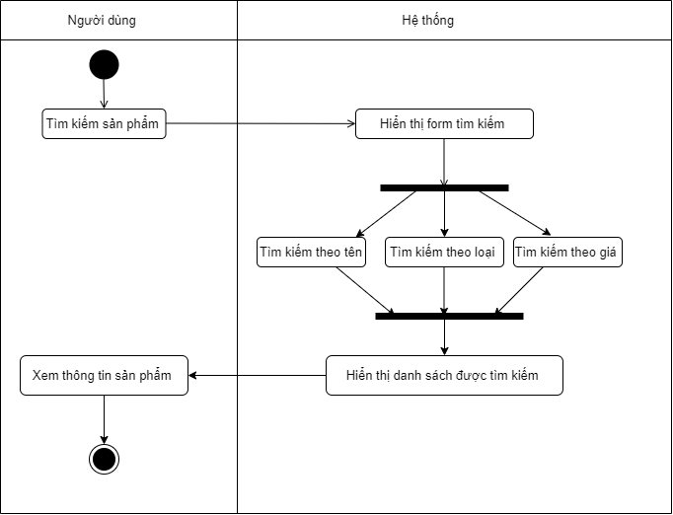
Activity diagram
Search activity diagram

Slide 16
4. Some program interfaces
16

Slide 17
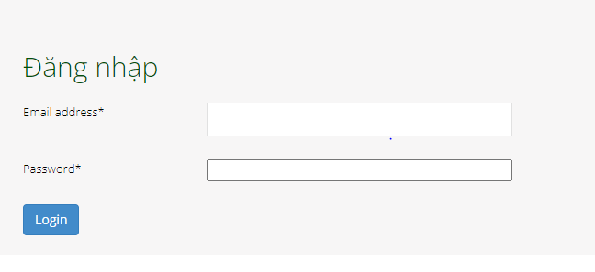
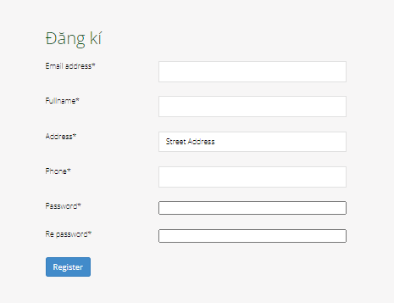

Slide 18
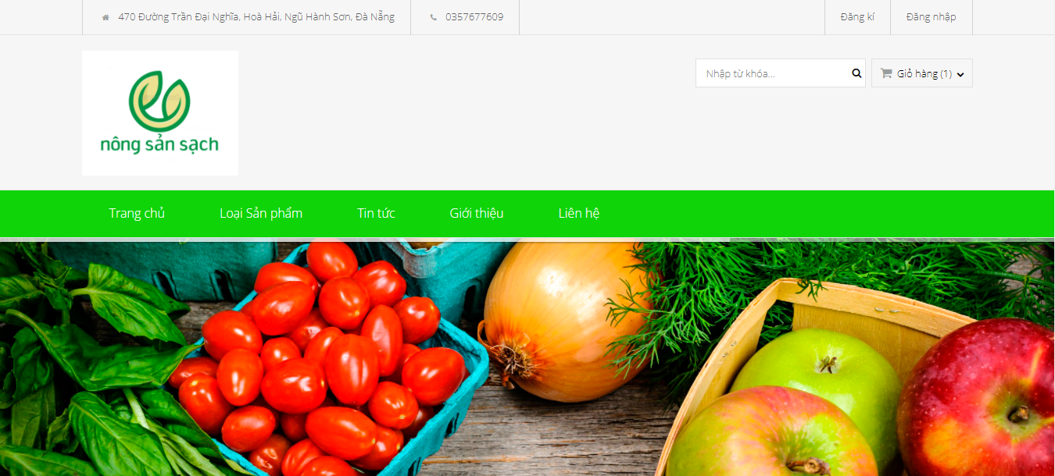
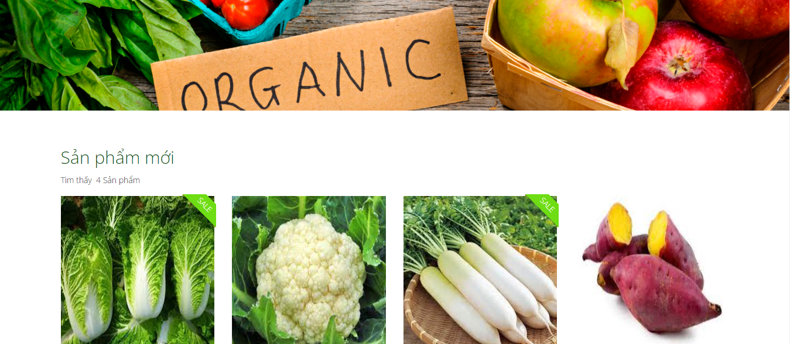

Slide 19
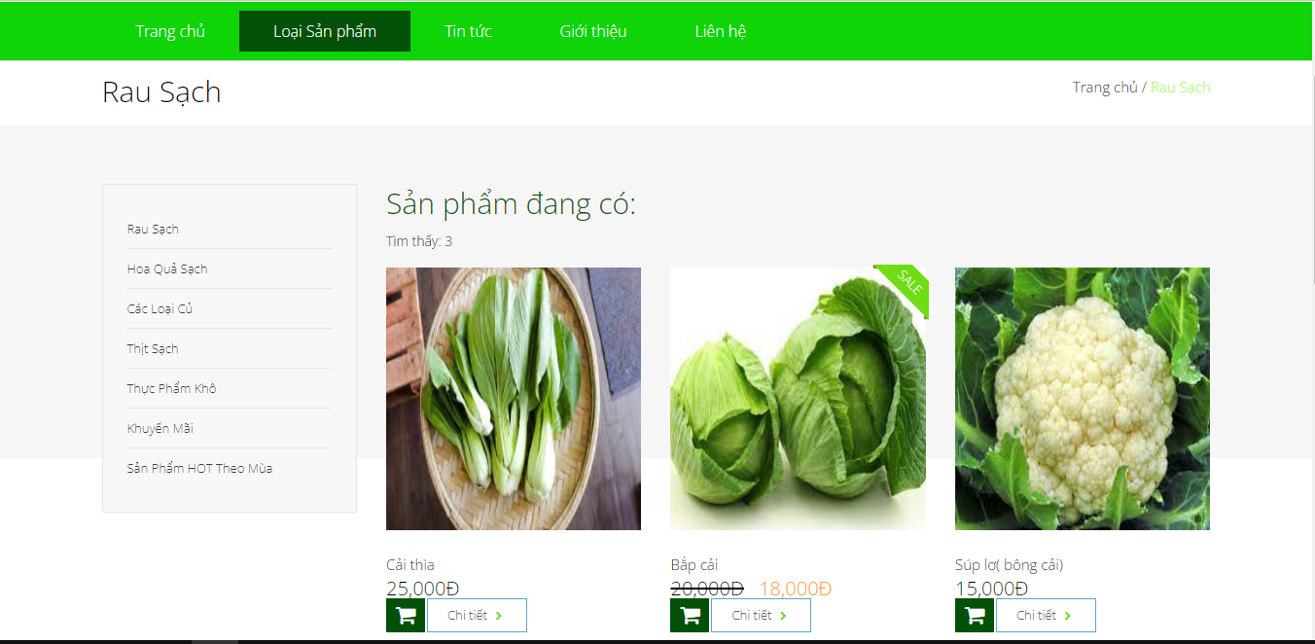

Slide 20
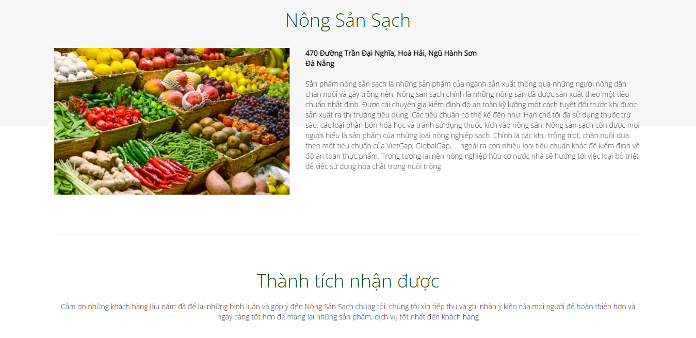

Slide 21


Thanks!
Any questions?
You can find me at:
ltthien.20it11@vku.udn.vn

